Slide 1
The Effect of Patriarchal Culture on Women’s Labor Force Participation
Ishac Diwan and Irina Vartanova
First draft, June 2016
Financial support by ERF is gratefully acknowledged. Support by the UNDP in the context of the preparation of background work for the Arab Human Development report, in the form of access to the Gallup data is also acknowledged.

Slide 2
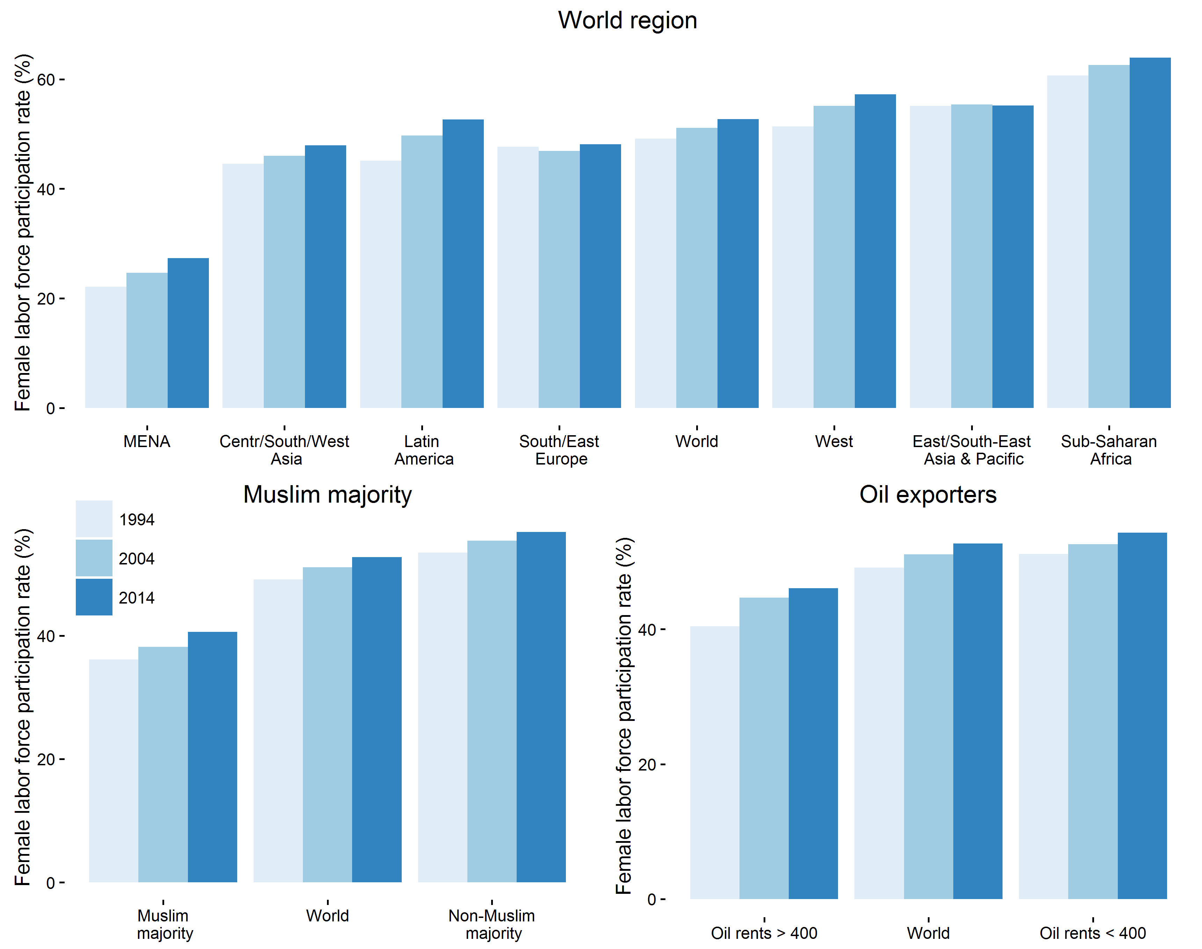
Regional estimates of female labor force participation rates, (adults 25 and older)

Slide 3
What explains FLFP variations?
Global/country literature:
Small variations through time/large variations through regions
Through time/development: a U curve, high FLFP for poor and rich countries
FLFP Rises with education.
But
What explains regional variation? If it is culture, how to measure it, and how does it play out in terms of country norms, personal variations, within household differences?
In which ways does education matter? Impact on wages, values, or women bargaining power?

Slide 4
plan
A micro/macro multi-level regression analysis
Cross-sectional, not time series
We measure patriarchal culture from opinion polls
We use World Value Survey – individual data on LFP and culture for about 80 countries around the world (but no usable data on incomes)
Replicate base model (education, regions)
Patriarchal values
Effect of individual and country patriarchal values on FLFP
Effect of P-values variability

Slide 5
1. FLFP:
Comparing data from ILO, WVS, and Gallup
Large regional variation that cannot be explained by economic considerations

Slide 6
FLFP rises with education regional variation remains, but falls, at higher levels of education

Slide 7
GDP/capita effect

Slide 8
multi-level modeling
Basic relation is between FLFP and education
We are interested in explaining cross country, and within country variation
Likely presence of heteroscedasticity suggests that we need to “model variance “
Basic model(s)
We use a linear ML probability model
Intercept depends on:
GDP capita and its square
Regional controls
individual characteristics
Education slope
First as one fixed slope for all countries
Second as “random effect”, where one slope is fitted by country, and MLM then computes an average

Slide 9
Independent variables
Middle education (low - ref) | Religious faith | Log GDP, squared, cubed
High education | Denom: None (Christ - ref) | Latin America
Married (single - ref) | Other | Centr/South/Western Asia
Divorced/Widowed | Muslim | Sub-Saharan Africa
1 child (0 - ref) |  | Eastern Asia
2-3 children |  | South/Eastern Europe
4 and more |  | MENA
Age <25 (>65 - ref) |  | Muslim country
26-35 |  | Oil country
36-45 | Arab country | Public sector
46-55 | Muslim country | Government expences
56-65 | Oil country | Manufacturing
 |  | agric

Slide 10
FLFP base model (1) Individual characteristics
 | WVS
Education middle (low = ref.) | 0.130***
Education High | 0.269***
Married (single - ref) | -0.189***
1 child (0 - ref) | -0.056***
4 and more children | -0.132***
Age 15-25 (>65 = ref) | 0.147***
Age 35 - 45 | 0.239***
Age 55 - 65 | 0.156***
Religious faith | -0.022***
Denom: None (Christ = ref) | 0.014*
Muslim | -0.103***

Slide 11
Results, base FLFP model, WVS (2) regional characteristics
 | w/o country specific slopes | Wt country C. specific slopes
Latin America (West - ref) | -0.122 | -0.038
Centr/South/Western Asia | -0.261*** | -0.145**
Sub-Saharan Africa | 0.131 | 0.065
Eastern Asia | -0.027 | -0.039
South/Eastern Europe | -0.034 | -0.009
MENA | -0.317*** | -0.191***
Public sector | 0.048** | 0.039***
observations | 63,920 | 63,920
Controlling also random intercept, and for GDPc and its square

Slide 12
“Random effects” education model: widely different effects of education on FLFP in regions
Effect of education on FLFP largest in MENA, lowest in the West

Slide 13
More generally, effect of high education highest when FLFP among uneducated low, but with country variationn

Slide 14
In sum
If culture is to “explain” FLFP, it should have:
The “right” macro correlations across countries – high patriarchy where FLFP “too” low
At the micro within country-level: a differential impact of the uneducated (large) and the educated (small), especially in the Middle East
Moreover, there is a question about the “meaning” of education – is it measuring wages, culture, or women’s bargaining power in the HH?

Slide 15
2. Patriarchal culture
Patriarchal Values (PV) involve a gender division of labor
Definition: average of a 3 variables index (standardized within 0-1 range):
When jobs are scarce, men should have more right to a job than women.
On the whole men make better political leaders than women do.
A university education is more important for a boy than for a girl.
Use ML-model to look at within and across country determinants of PV

Slide 16
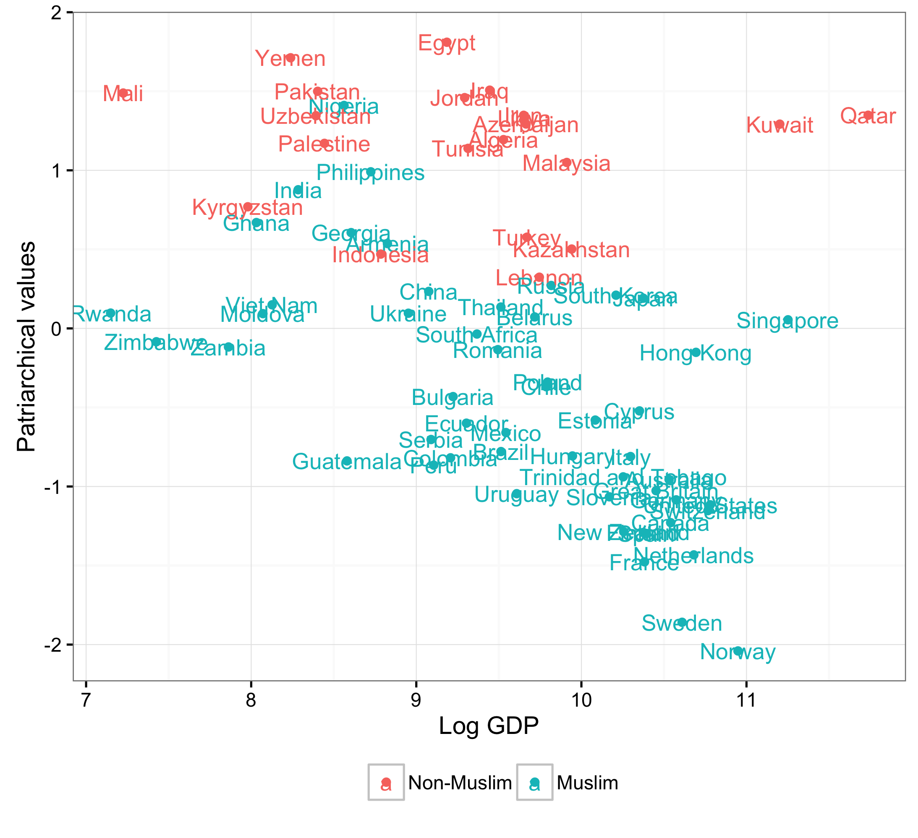
Values in regions (WVS)

Slide 17
P-Values (1) – individual effects - WVS
Female | -0.097***
Edu middle (low – ref) | -0.058***
High | -0.107***
Married (single – ref) | 0.012***
1 child (0 – ref) | 0.005*
4 and more children | 0.023***
Age <25 (>65 – ref) | -0.035***
25 – 35 | -0.039***
45 – 55 | -0.045***
Religious faith | 0.022***
Denom: None (Christ – ref) | -0.016***
Muslim | 0.042***

Slide 18
Values 2: regional effects – largest PV in MENA and CWS Asia
South/Eastern Europe | 0.123***
Latin America | 0.026
Centr/South/Western Asia | 0.257***
MENA | 0.258***
Eastern Asia | 0.222***
Sub-Saharan Africa | 0.177***

Slide 19
3. FPLP and culture

Slide 20
FLFP individual characteristics (1)
 | Fixed effects | Random effects
Middle education (low - ref) | 0.125*** | 0.112***
High education | 0.257*** | 0.248***
Married (single - ref) | -0.192*** | -0.187***
1 child (0 - ref) | -0.053*** | -0.053***
4 and more | -0.123*** | -0.119***
Age <25 (>65 - ref) | 0.150*** | 0.150***
36-45 | 0.239*** | 0.236***
56-65 | 0.153*** | 0.151***
Religious faith | -0.018*** | -0.015***
Muslim (Christ - ref) | -0.100*** | -0.098***

Slide 21
Regional effects go away (2) wt random education effects
 | Fixed slope | Random slope
Country PV | -0.095** | -0.082**
Individual PV | -0.020*** | -0.019***
Latin America (West - ref) | -0.112* | -0.020
Centr/South/Western Asia | -0.117 | -0.025
Sub-Saharan Africa | 0.258** | 0.174
Eastern Asia | 0.100 | 0.081
South/Eastern Europe | 0.028 | 0.045
MENA | -0.128 | -0.049

Slide 22
Arab, Muslim, or Oil effect?
values | 1 | 2 | 3 | 4 | 5. Random Effects
Patriarchal Values
Arab country | 0.225*** |  |  | 0.056 | 0.044
Muslim majority c. |  | 0.227*** |  | 0.181*** | 0.146***
Oil country |  |  | 0.131*** | 0.036 | 0.032
FLFP
Arab country | -0.298*** |  |  | -0.106 | -0.094*
Muslim country |  | -0.283*** |  | -0.229*** | -0.003
Oil country |  |  | -0.130** | 0.007 | 0.007

Slide 23
Structural effects
FLFP is often said to also depend on supply of jobs, and especially jobs “fit” for women, such as in the public sector, or manufacturing.
We do find a strong positive effect of size of public sector, but not of size of agriculture or manufacturing (but also controlling for GDP).

Slide 24
4. The various effects of education Is there an additional bargaining effect?
Emancipation: effect of education on values – by controlling for personal values
Wages: economic attraction of work –education as a proxy
Bargaining power: education confers more power when the value gap is large – use education*variance PV
Hypothesis is that education confers more bargaining power when gender gap is larger

Slide 25
Bargaining with whom?
Gender gap: Bargaining wt males (husband? Father?) -> both Middle and High Edu effects, stronger effect for HE
Age gap: Bargaining wt the old (parents?) -> for ME only
Education gap: Bargaining wt the less educated (traditional community?) -> for ME only

Slide 26
Effects of gender, education, and age on P-values
Gender gap (male-female) largest in Mena and SSA
education gap (none vs high edu) largest in LAC and EAP
Age gap most marked in West and EE

Slide 27
PV Age gap (2)

Slide 28
Effects of (country-level) value gaps on FLFP
Education middle level | 0.114*** | 0.116*** | 0.115*** | 0.114***
Education high level | 0.254*** | 0.254*** | 0.253*** | 0.251***
Individual values | -0.020*** | -0.020*** | -0.020*** | -0.020***
Country values | -0.146*** | -0.079** | -0.074** | -0.071**
Middle Edu*Country values | 0.009
High Edu * Country values | 0.084***
Gender gap |  | -0.038
Middle Edu* Gender gap |  | 0.034*
High Edu* Gender gap |  | 0.059**
Educational gap |  |  | -0.010
Middle Edu* Educational gap |  |  | 0.032*
High Edu* Educational gap |  |  | 0.001
Age gap |  |  |  | -0.018
Middle Edu* Age gap |  |  |  | 0.041**
High Edu* Age gap |  |  |  | 0.019

Slide 29
Main findings
Individual values matter in addition to education, suggesting that education matters both because it raises wages, and its effects on “emancipation”
Country variability in values* education also matters, suggesting that education also increases women’s bargaining
Thus education policies can have a great influence in beating local “culture” through triple effect of wages, emancipation, and bargaining

